Slide 1
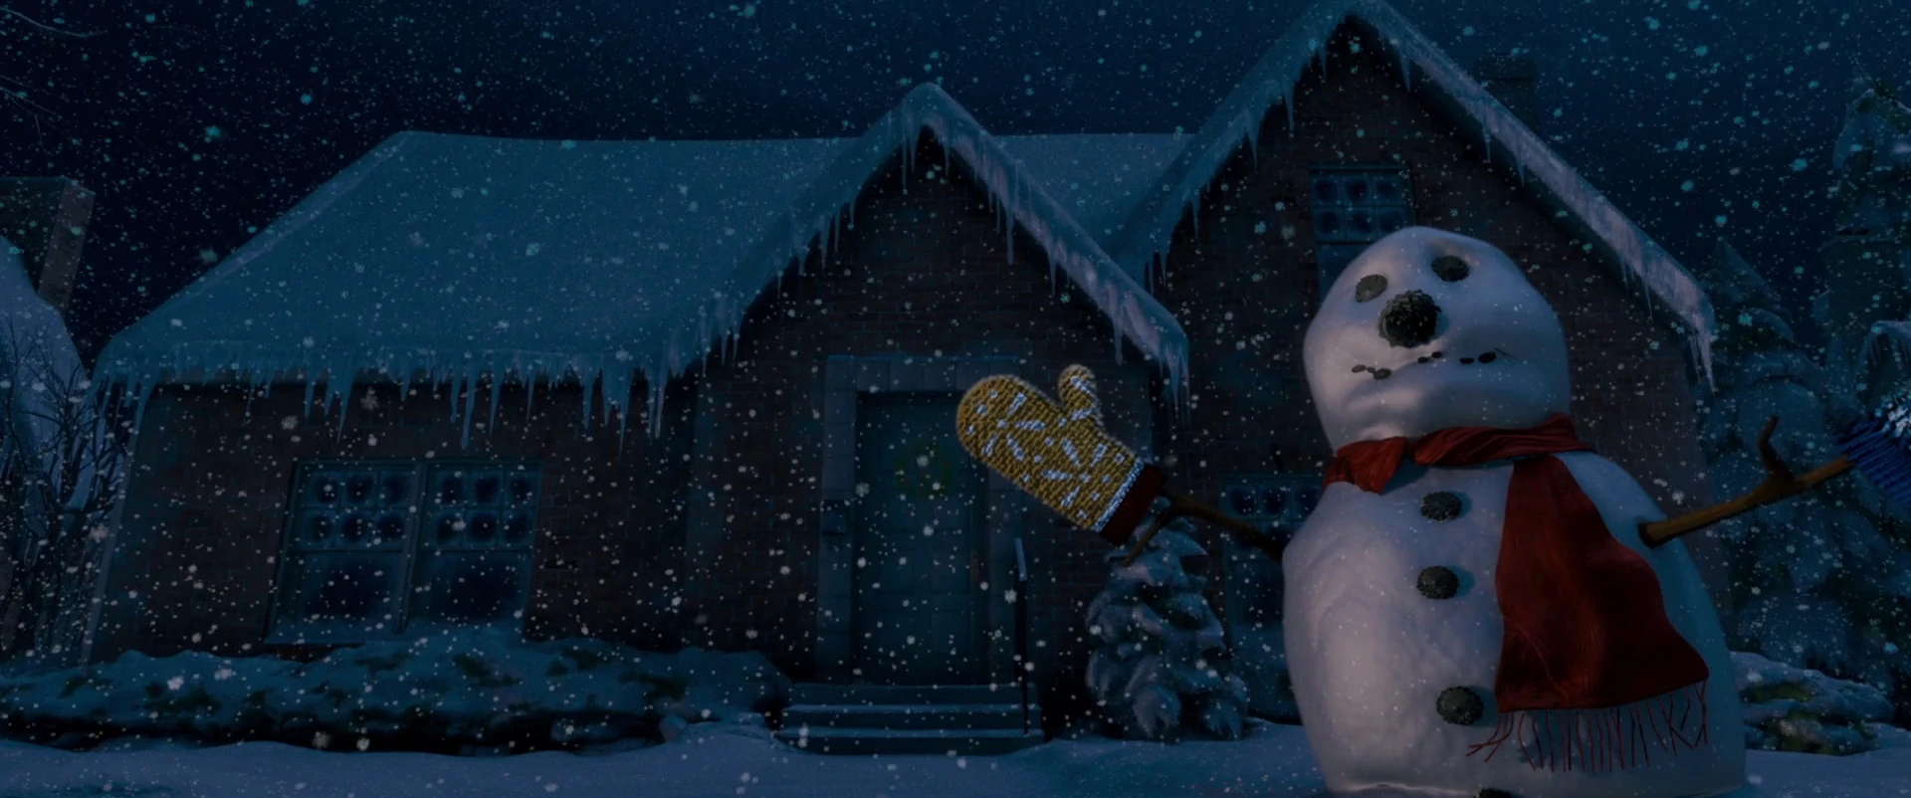

Slide 2


Slide 3


Slide 4
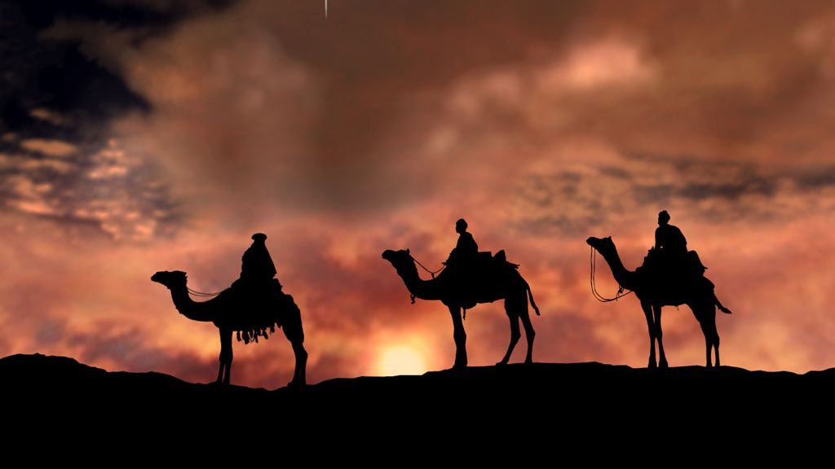

Slide 5


Slide 6
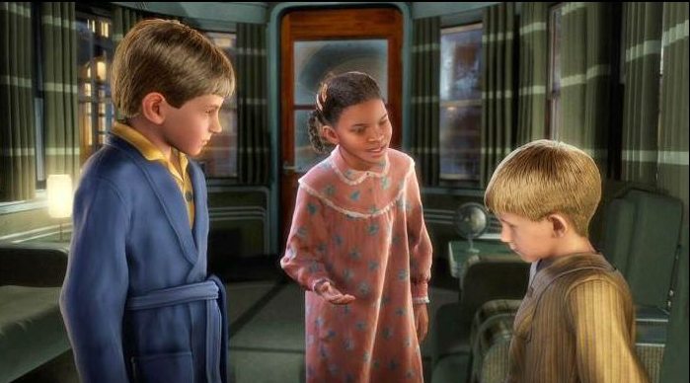

Slide 7


Slide 8
“There is something interesting, almost paradoxical, about this path and adventure we have chosen: the only way for you to progress in your gospel adventure is to help others progress as well.”
~Elder Dieter F. Uchtdorf

Slide 9
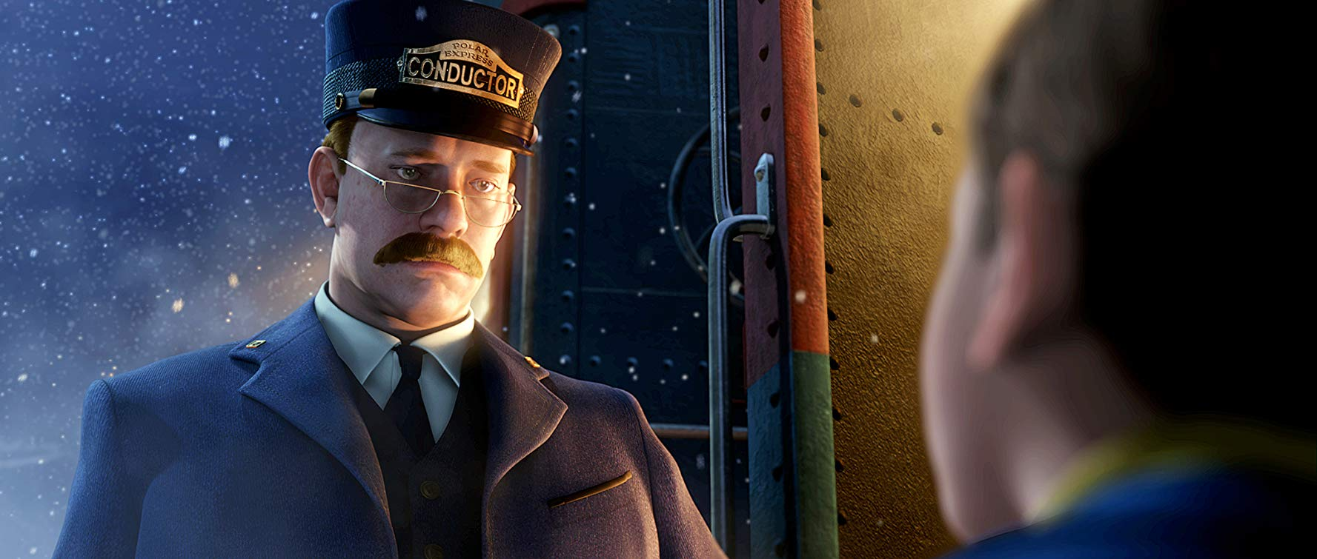

Slide 10
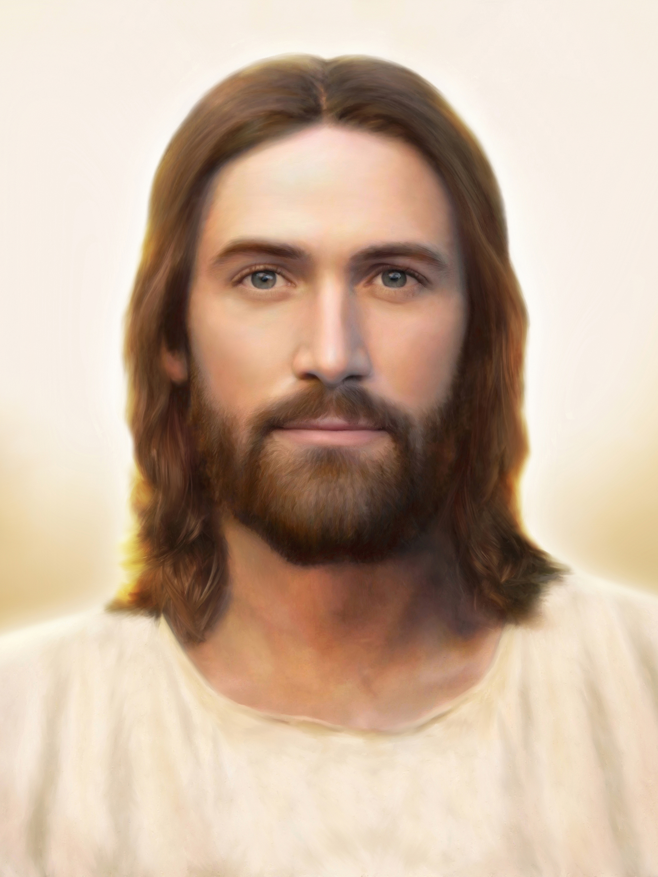

Slide 11
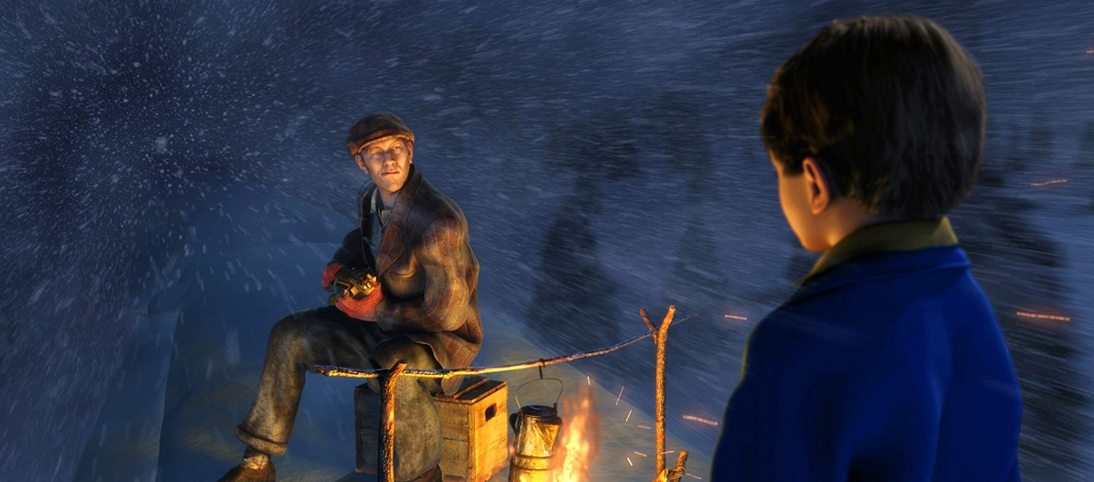

Slide 12
“As we live up to our covenants, the angels will not be able to be restrained from
being our associates.
Ask for angels to help you…Literally!”
~Sister Wendy W. Nelson

Slide 13
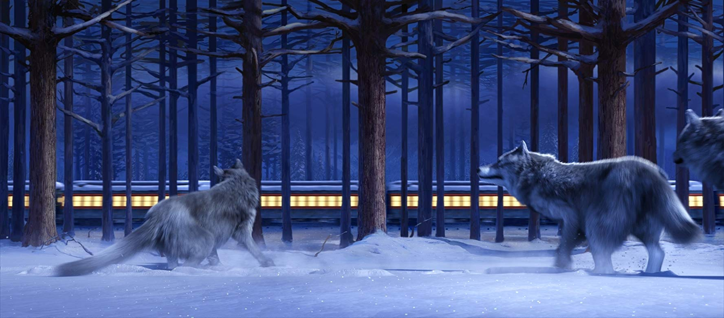

Slide 14
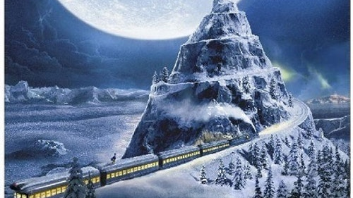

Slide 15
“Life is like an old time rail journey—delays, sidetracks, smoke, dust, cinders, and jolts, interspersed only occasionally by beautiful vistas and thrilling bursts of speed. The trick is to thank the Lord for letting you have the ride.”
~As quoted by President Gordon B. Hinckley

Slide 16
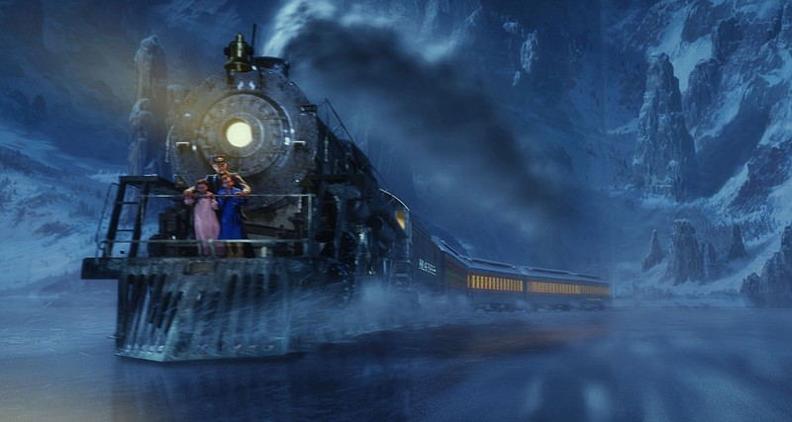

Slide 17
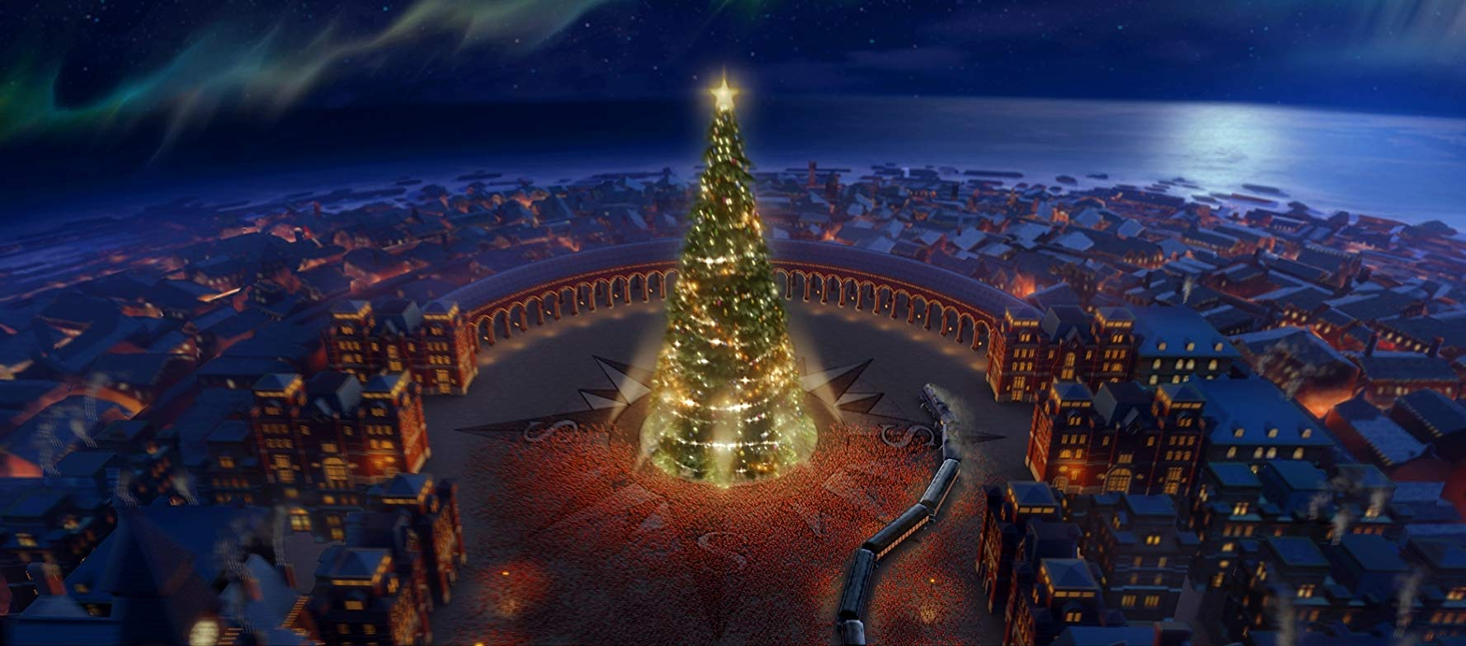

Slide 18


Slide 19
“For some, the act of believing is difficult. Sometimes our pride gets in the way. Perhaps we think that because we are intelligent, educated, or experienced, we simply cannot believe in God. And we begin to look at religion
as foolish tradition.”
~Elder Dieter F. Uchtdorf

Slide 20
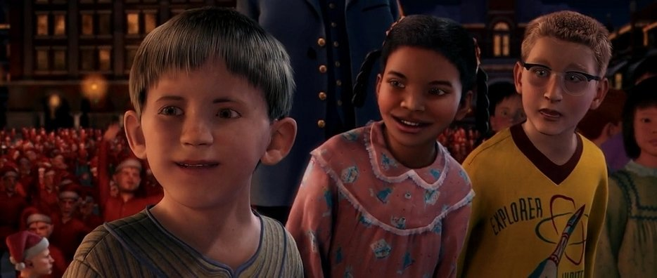

Slide 21
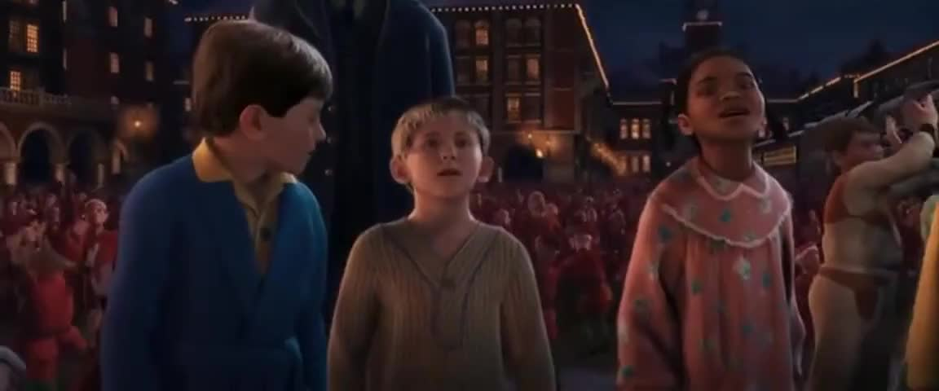

Slide 22
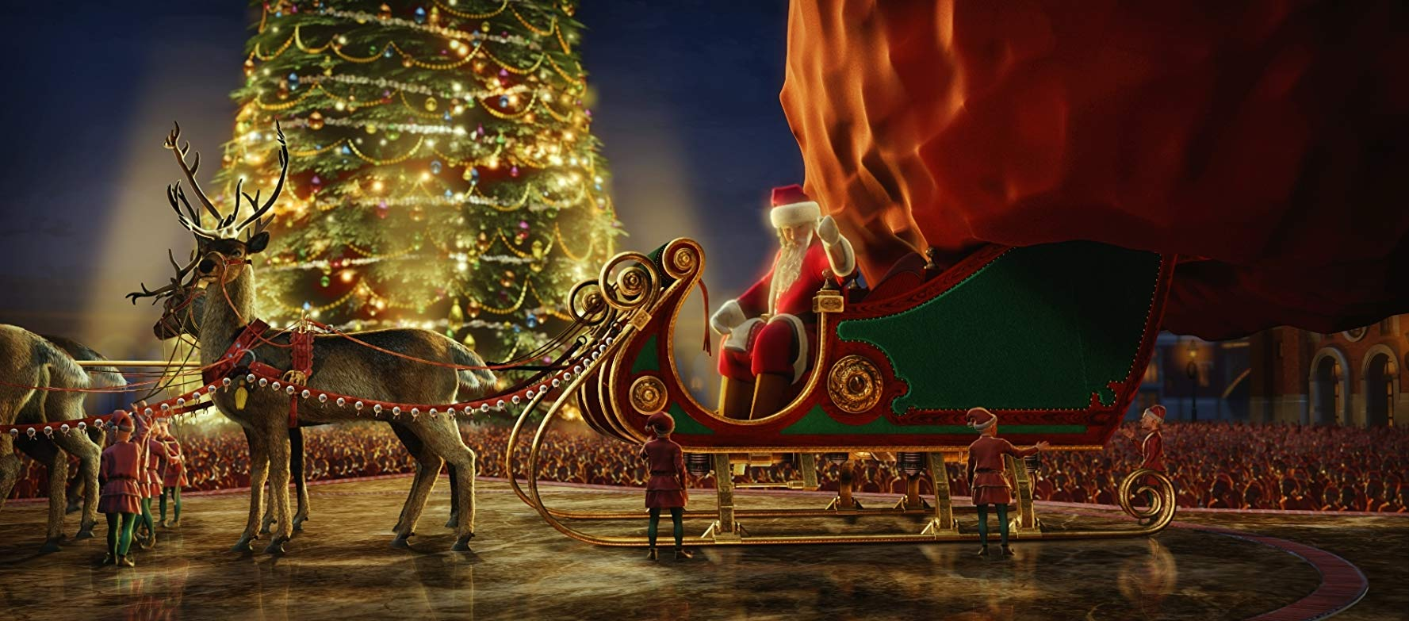

Slide 23
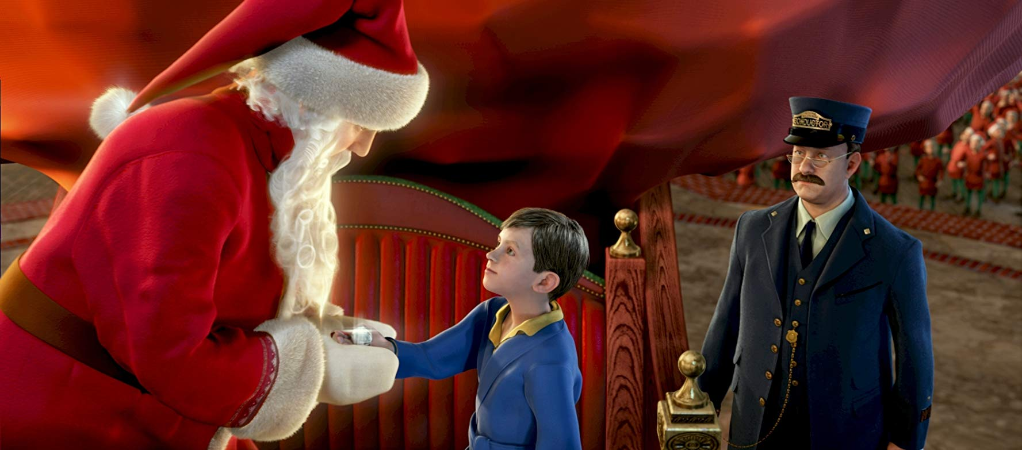

Slide 24
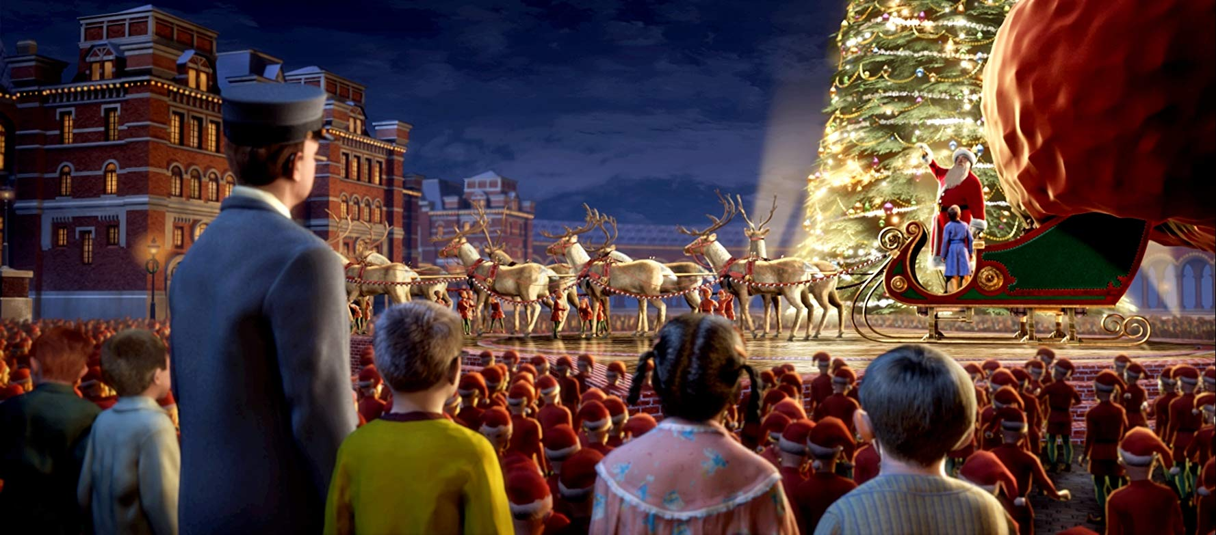

Slide 25
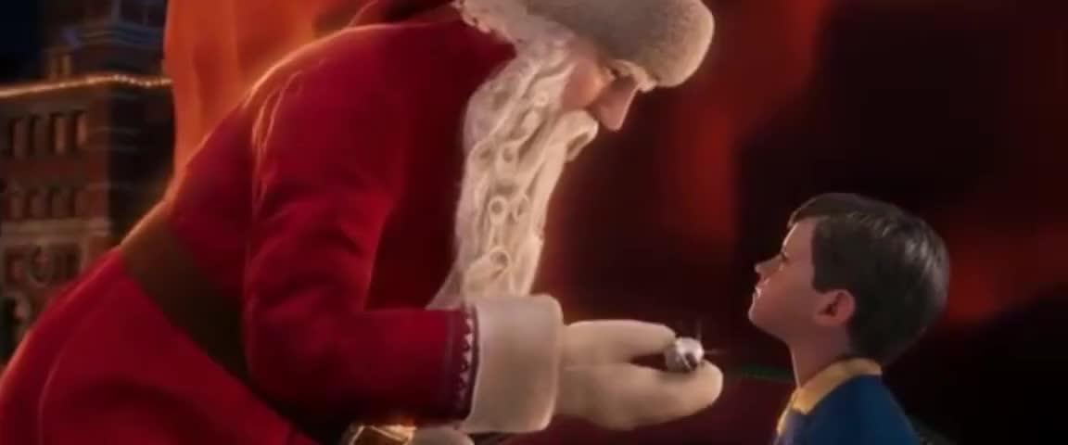

Slide 26
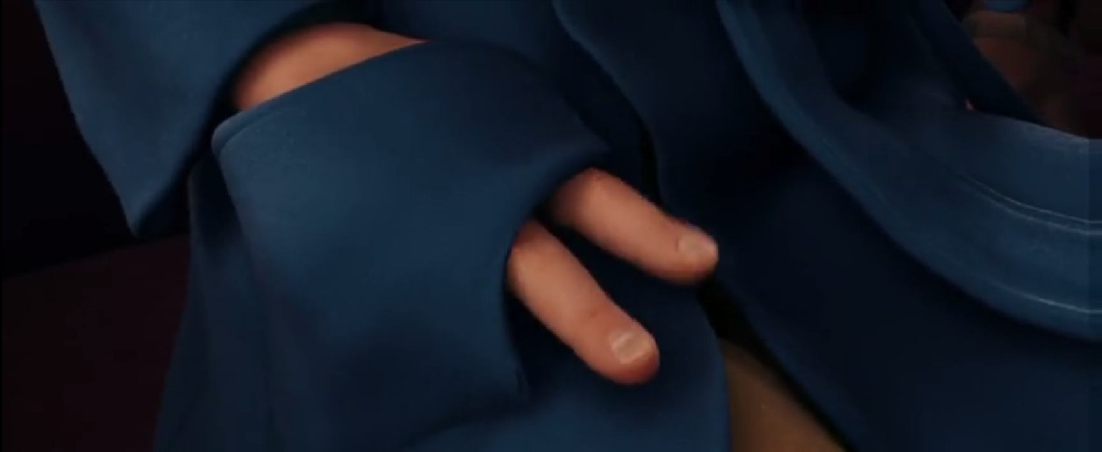

Slide 27


Slide 28
“In my experience, belief is not so much like a painting we look at and admire and about which we discuss and theorize.
It is more like a plow that we take into the fields and, by the sweat of our brow, create furrows in the earth that accept seeds and bear fruit that shall remain.”
~Elder Dieter F. Uchtdorf

Slide 29
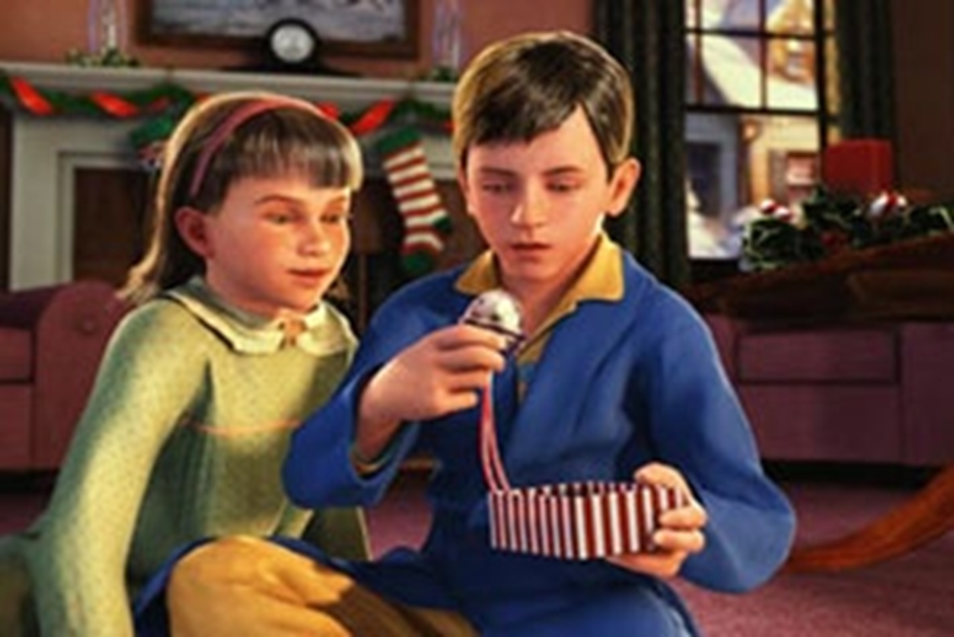

Slide 30
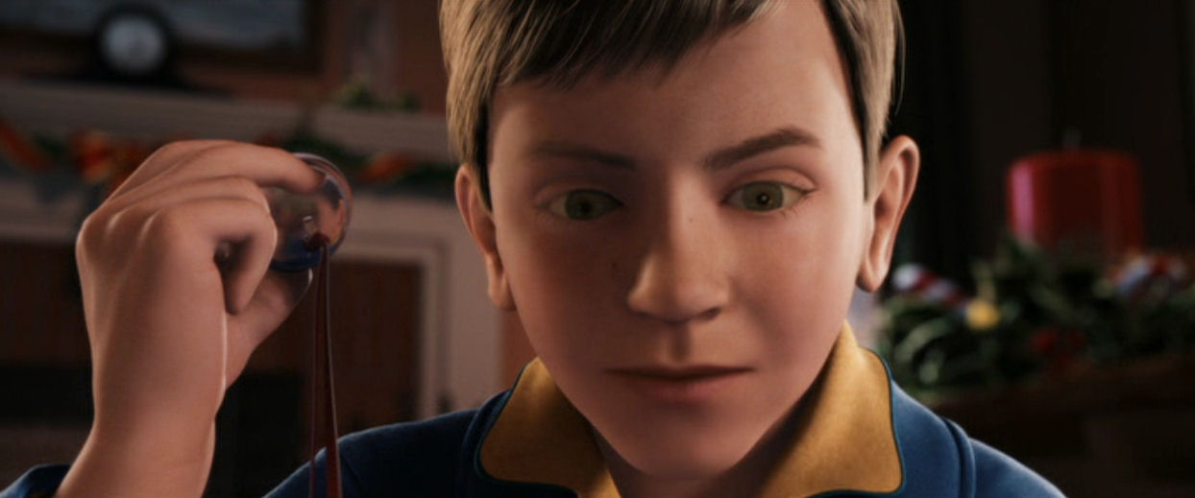

Slide 31
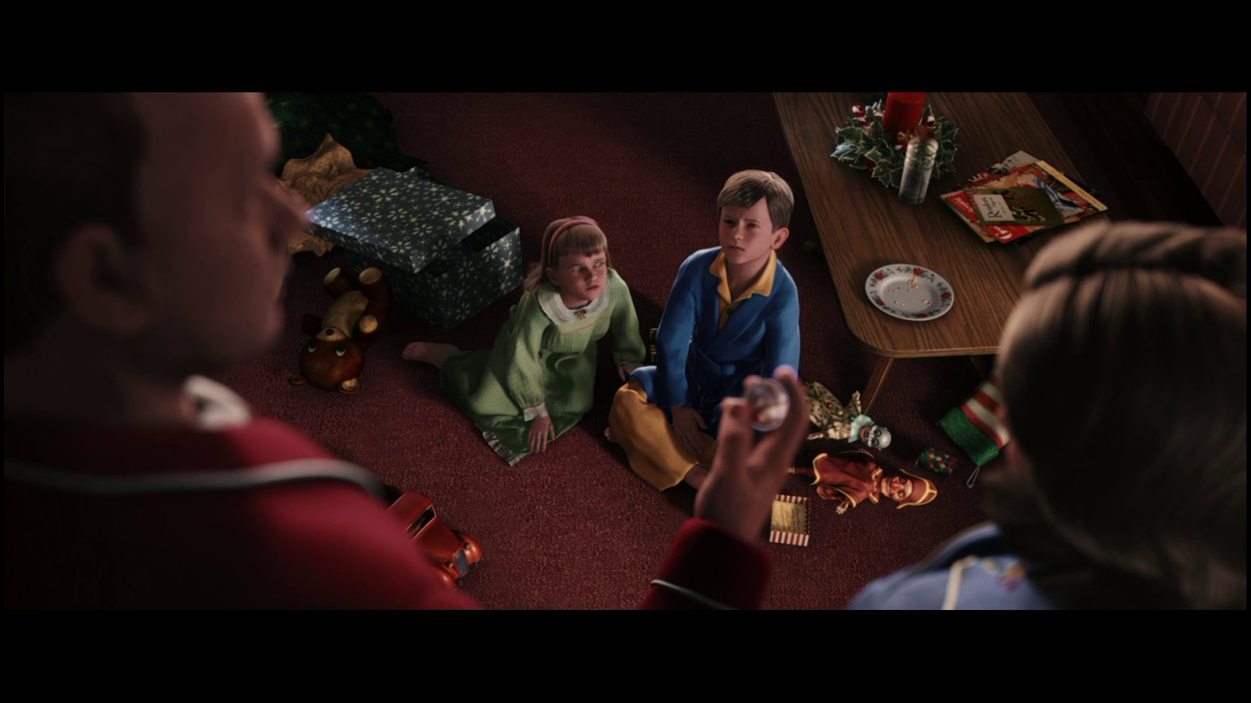

Slide 33
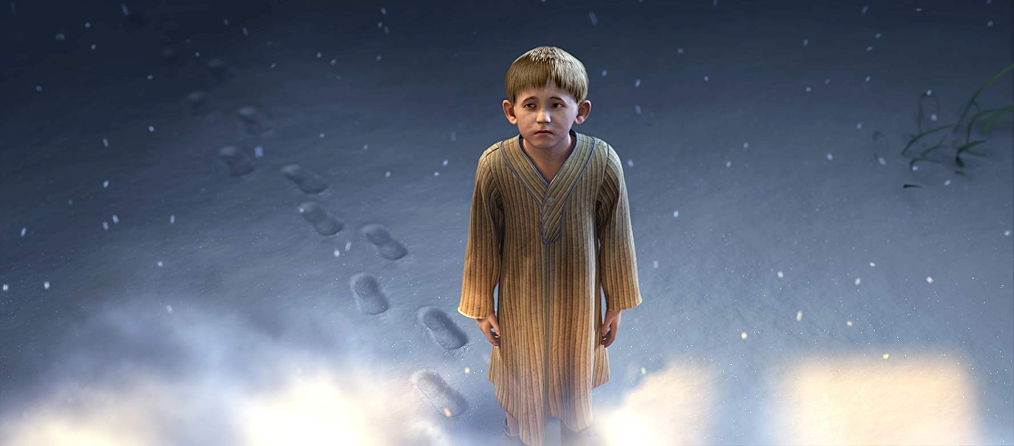

Slide 34


Slide 35


Slide 36
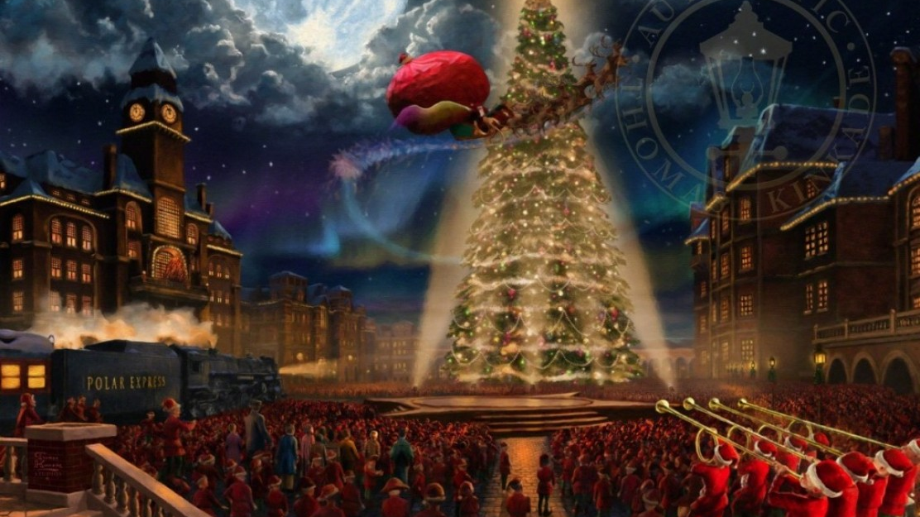

Slide 37
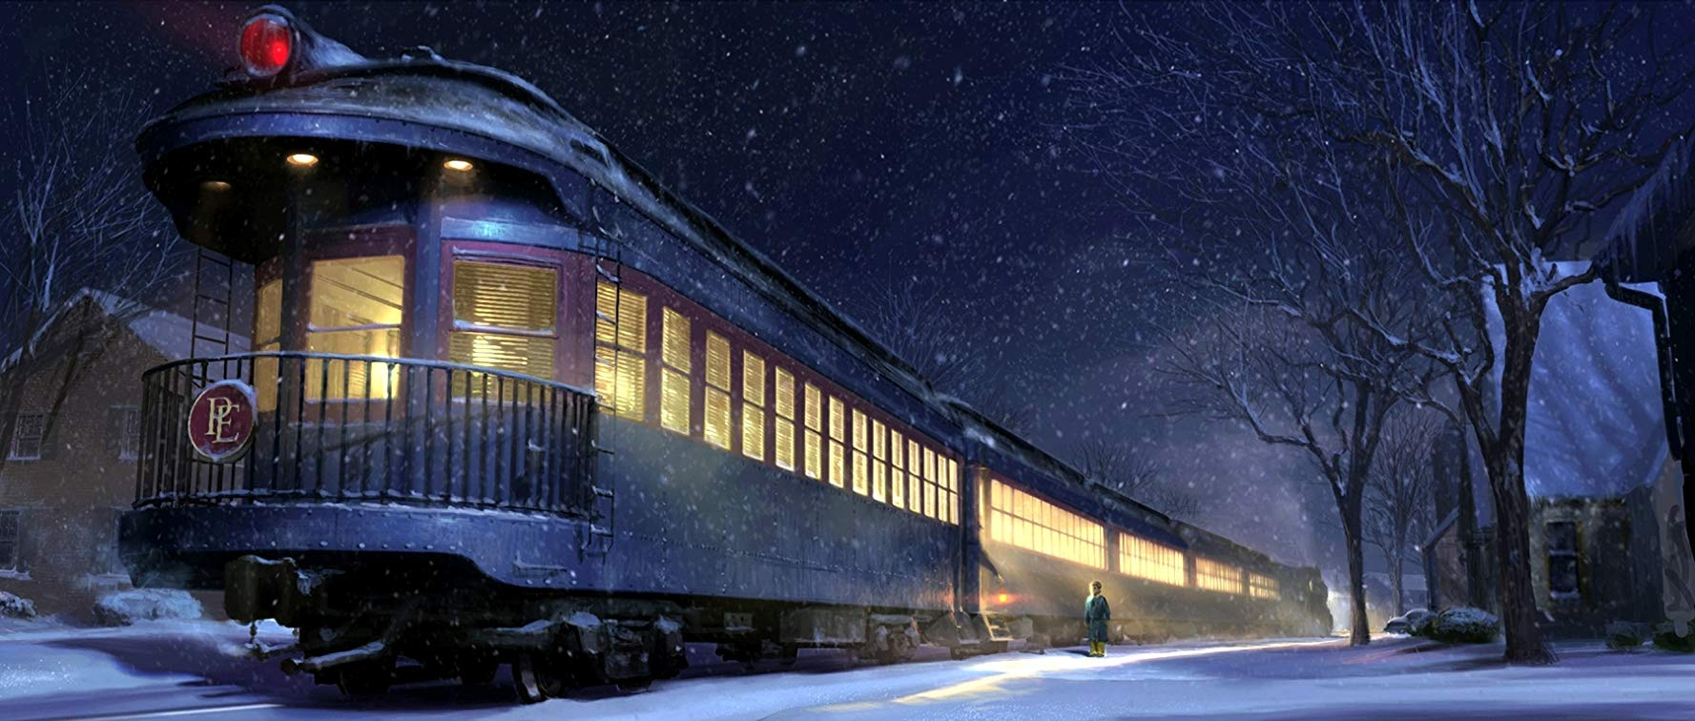

Slide 38
“We could spend a lifetime waiting for that moment when everything lines up perfectly. But now is the time to commit fully to seeking God.
Come and see what this marvelous, wondrous,
and adventurous journey is all about.
Draw near to God, and He will draw near to you.
This is the promise to all who seek to believe.”
~Elder Dieter F. Uchtdorf

Slide 39
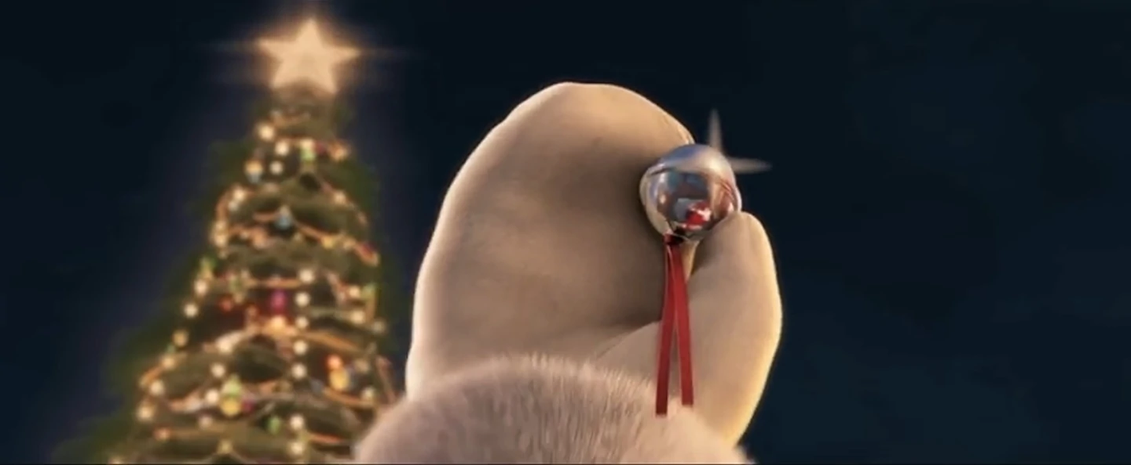

Slide 40
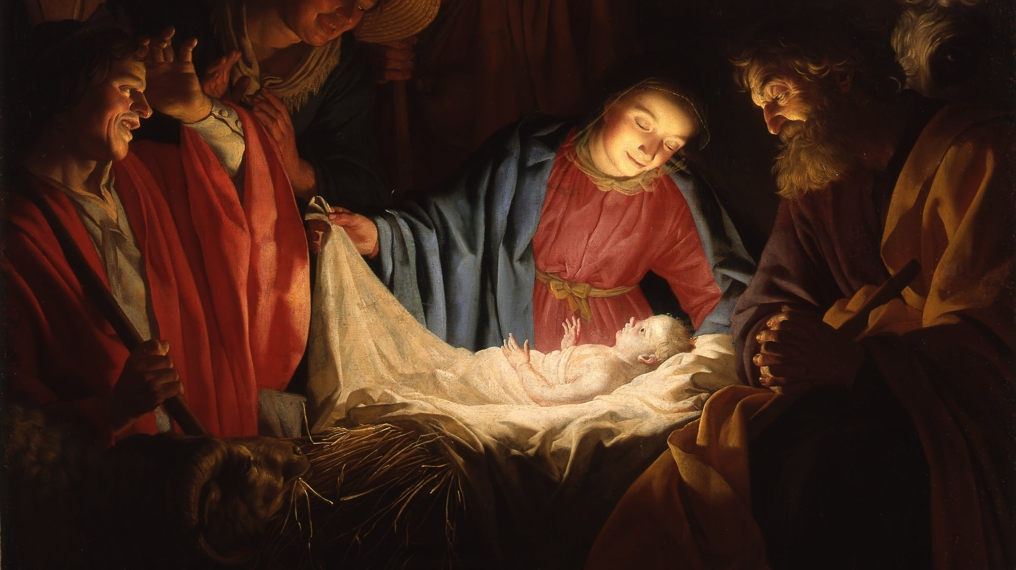

Slide 41
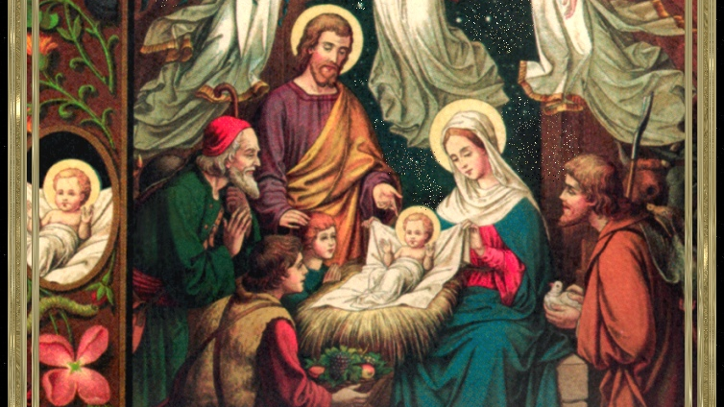

Slide 42
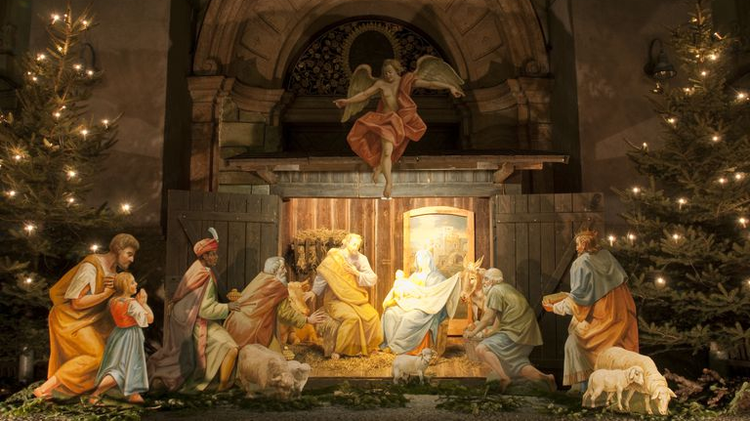

Slide 43
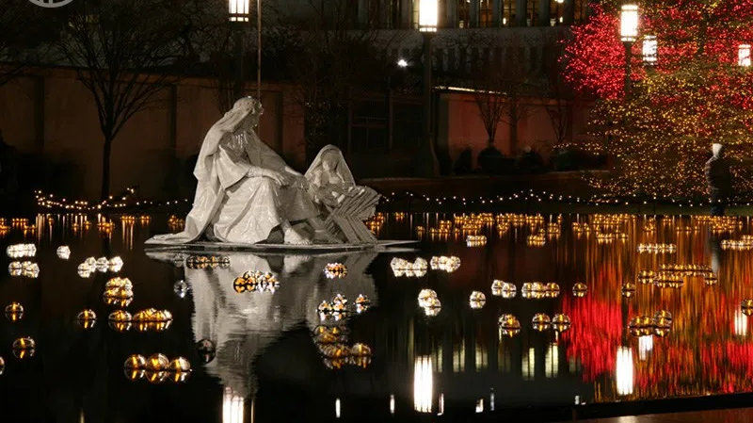

Slide 44
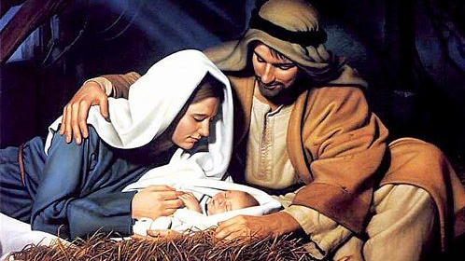

Slide 45
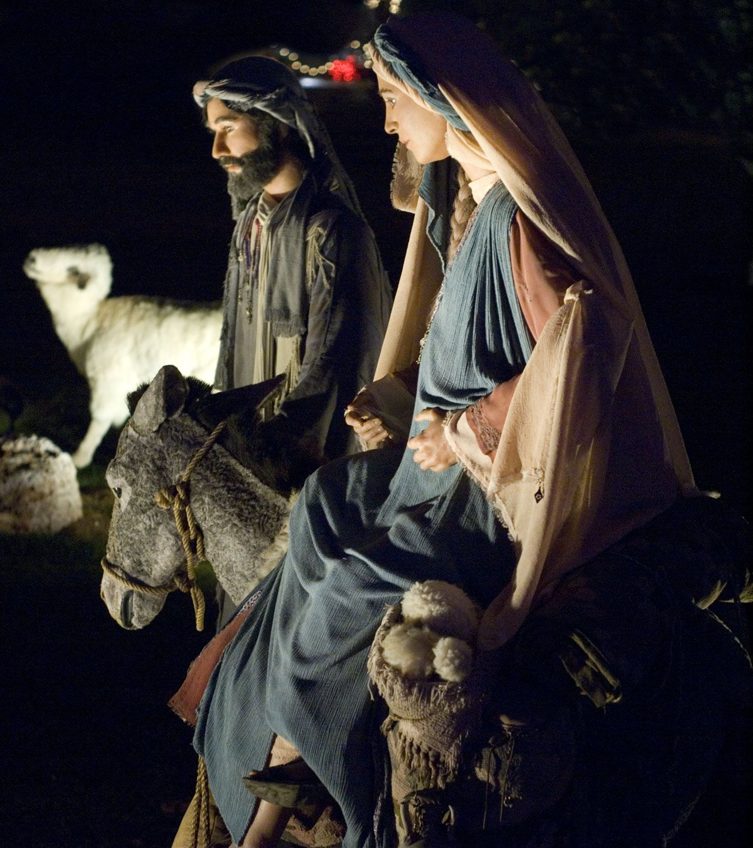

Slide 46
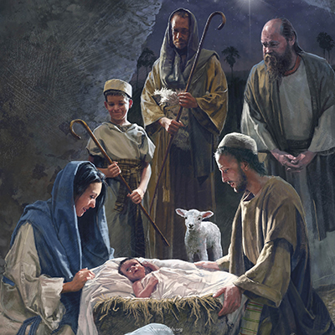

Slide 47
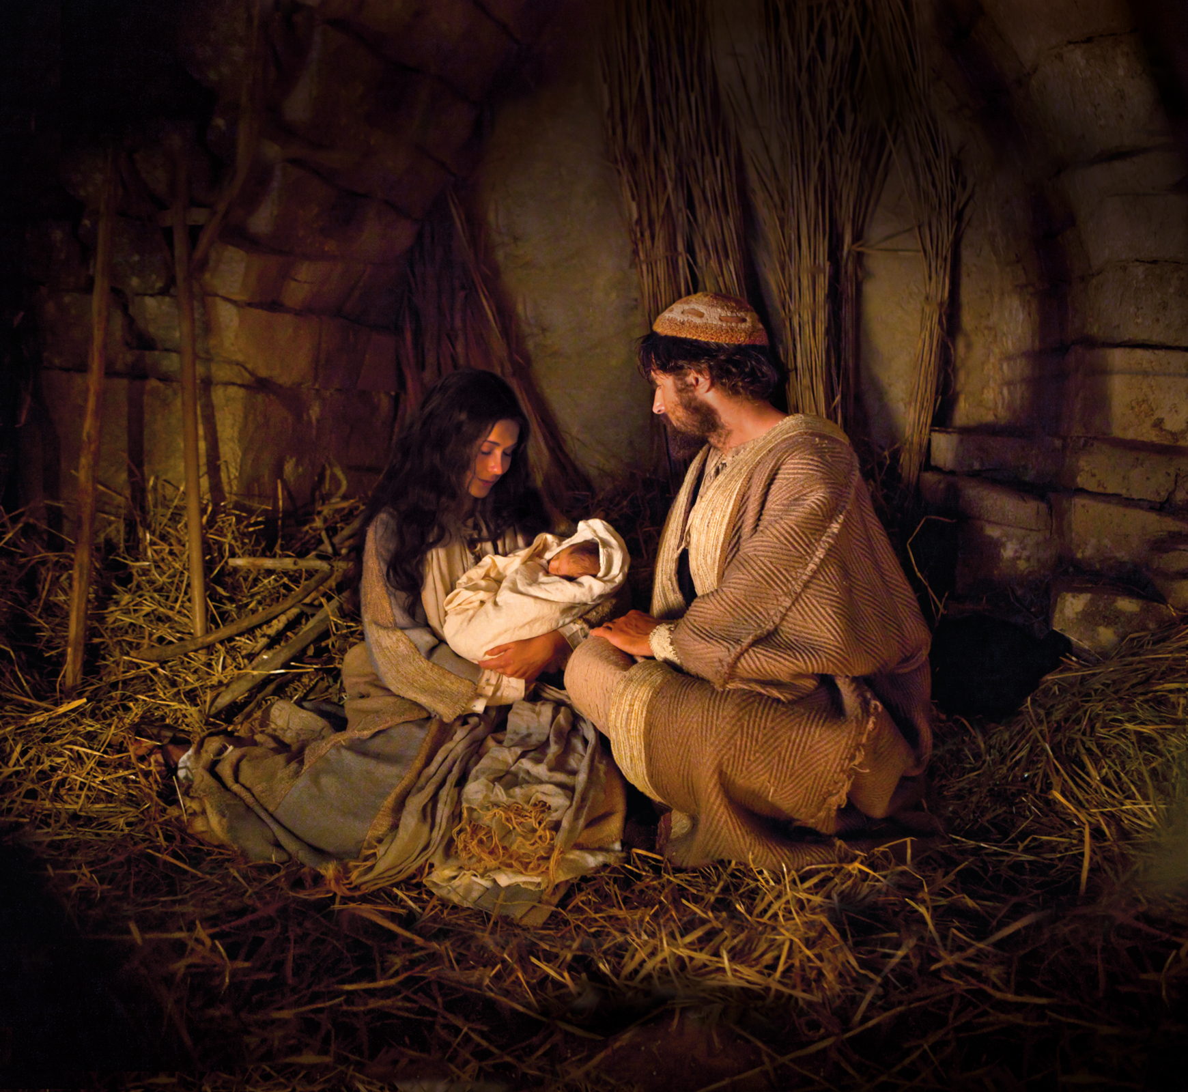

Slide 48
